Slide 1
Game Theory in Artificial Intelligence
As applied to backgammon
Presented by:
Frenchie and Esteban

Slide 2
What is AI?
Definitions:
Thinking Humanly “[The automation of] activities that we associate with human thinking, activities such as decision-making, problem solving, learning …” (Bellman, 1978) | Thinking Rationally “The study of the computations that make it possible to perceive, reason, and act.” (Winston, 1992)
Acting Humanly “The study of how to make computers do things at which, at the moment, people are better.” (Rich and Knight, 1991) | Acting Rationally “Computational Intelligence is the study of the design of intelligent agents.” (Poole et al., 1998)
For our project: Acting Rationally
Notes:
Artificial intelligence is the field of understanding how we think and how to build intelligent entities.
-Josh

Slide 3
Game Theory in AI
Environments
Multiagent competitive environment
Games
Game Theory
Agents = players
Environment = state
Notes:
-Josh

Slide 4
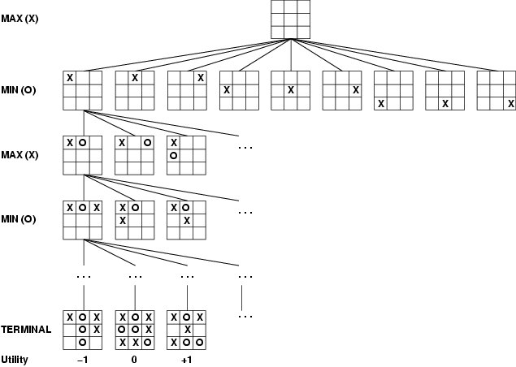
Introduction
Most are turn-taking, two-player, zero-sum games of perfect information. (tic tac toe)
Notes:
-josh

Slide 5
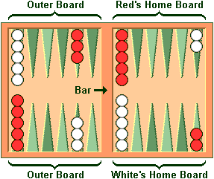
The project
Apply game theory to an AI for backgammon
Backgammon Intro:
Goal: remove all your checkers from board
Movement of the checkers
Notes:
Roll, doubles, moves, bar, and bearing off
-Esteban

Slide 6
Game Formulation
Turn-taking, two-player, zero-sum game with perfect information
Players: 2 players (AI and Human)
Strategies: Actions (set of checker moves based on dice roll)
Utility: -1 (Lose), 1 (Win)
Is it deterministic?
NOOOOOOO
Notes:
-Esteban

Slide 7
Stochastic Games
Stochastic games vs. deterministic games:
(pic here)
Notes:
-Josh

Slide 8
Nash Equilibrium
We theoretically could backtrack… but
21 possible rolls with 2 dice
Given the dice roll, ≈ 20 legal moves on average
Rolling doubles!!!!
depth 4 = 20×(21×20)3 ≈ 1.2×109
Computationally expensive!!
So what now?
Notes:
-Esteban

Slide 9
Approaches/Past work
Approaches
Monte Carlo pruning
Minimax pruning
Past Work
Reinforcement learning with neural networks
TDGammon
BKG program
Notes:
-Josh

Slide 10
What are we doing?
Evaluation function (estimation)
Blot Danger
Blockading factor
Home Board factor
Bearing Off
Spacing of checkers
Other possible factors but they are very involved
Notes:
-Esteban

Slide 11
What have we done?
Enumerated all legal moves (given a roll and state)
The game is playable (screenshot)
Notes:
-Esteban

Slide 12
What’s left?
Implement the evaluation function
Set up the AI
Evaluation of the AI
Notes:
-Esteban

Slide 13
References
www.bkgm.com
Artificial Intelligence A modern Approach – Stuart Russell and Peter Norvig
“BKG, a Program That Plays Backgammon” - Hans J. Berliner

